Slide 1

Analyzing Bus On-Time Performance in Greater Nashville and Davidson County
Notes:
Slide 1--Title Slide Speaker Notes:
Good afternoon everyone and thank you for joining us. Our team analyzed WeGo Public Transit’s bus system, which serves the Greater Nashville and Davidson County area.
Our goal was to use data to understand what affects on-time performance — things like routes, driver behavior, and even the time of day.
By studying these patterns, we hope to identify where WeGo could improve reliability and make commuting smoother for passengers.

Slide 2




Break It Easy
Mike Phillips
Jocelyn Williams
Joseph Deal
Brandon Gray
Notes:
Slide 2- Group intro

Slide 3
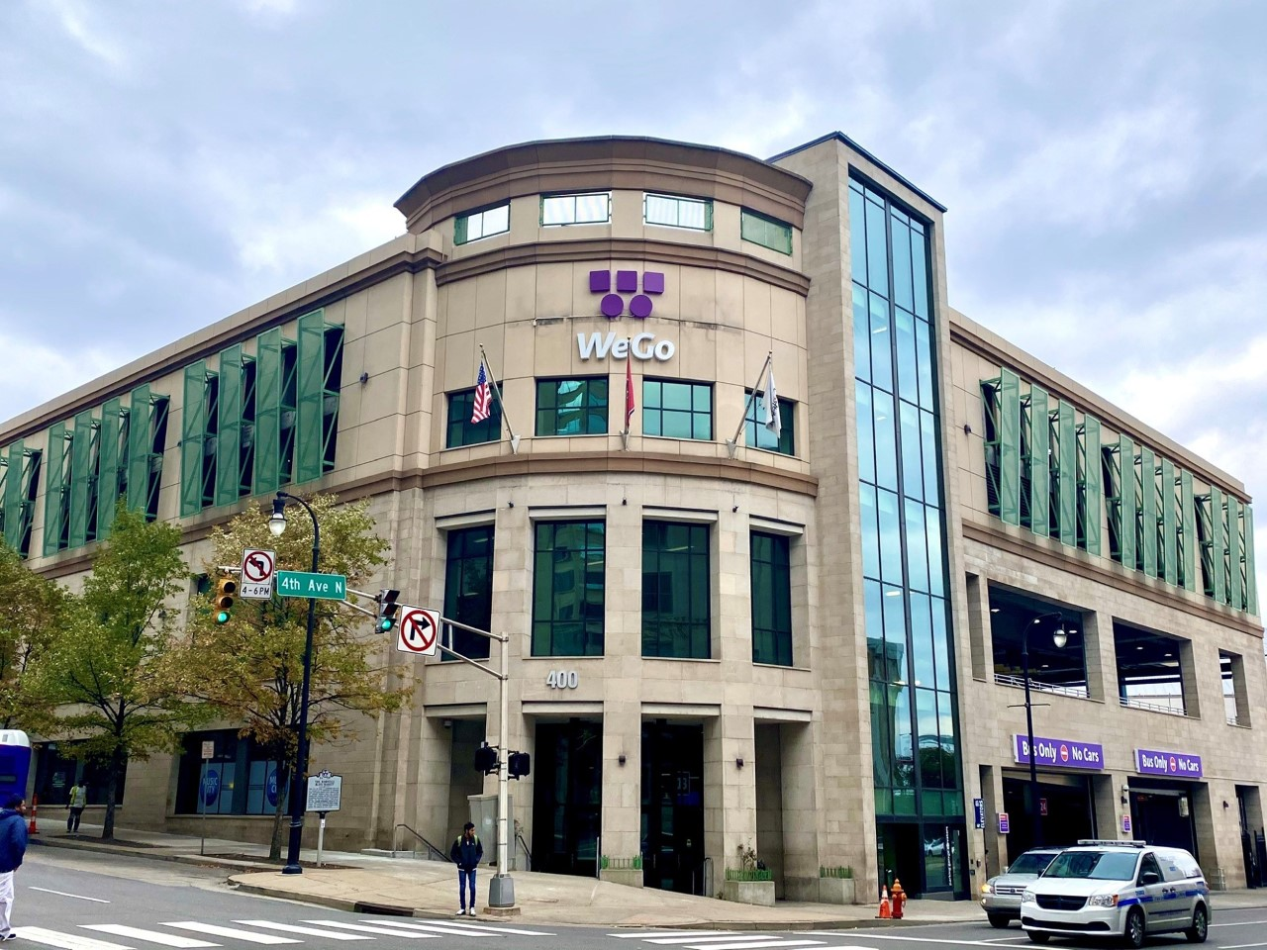
What We Analyzed
Service Reliability Across the System Measured on-time performance (OTP) for all timepoints, routes, and directions to understand how consistently buses adhere to their schedules.
Factors That Influence Reliability Examined route, direction, time of day, operators, layover length, and trip progress to see where and when reliability tends to change.
Passenger Experience Indicators Analyzed spacing between buses (headways) to identify bunching, gaps, and overall evenness of service that riders experience.
Notes:
Slide 3--Project Overview Speaker Notes:
This project focuses on WeGo’s bus system, using real operational data to understand patterns of delays and performance. We looked at arrival times, layovers, routes, and operators to determine what influences punctuality. Our objective was not just to describe the delays, but to uncover what causes them and how they can be reduced.

Slide 4
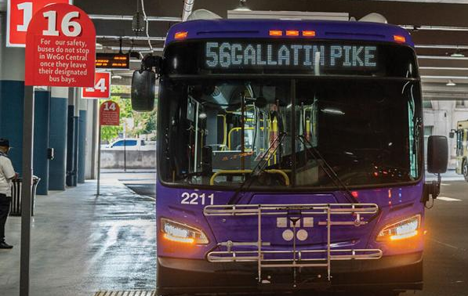
How We Analyzed It
Data Sources and Scope Used WeGo’s timepoint-level operational data (August–September 2023), enriched with schedule, operator, and headway information for every recorded trip.
Policy-Aligned On-Time Rules Applied WeGo’s service standards for early, late, and on-time definitions — including waiver logic — to create a reliable performance subset.
Analytical Approach Built reproducible datasets and visualizations in Python and Jupyter Notebook to examine patterns by route, time, operator, and geography, ensuring that findings are transparent and data-driven.
Notes:
Slide 4--Data Preparation & Methods Speaker Notes:
Step 1: Cleaned and filtered missing values.
Step 2: Calculated adjusted 'on-time', 'early', and 'late' metrics.
Step 3: Grouped by route, direction, operator, and time of day.
Step 4: Visualized results with appropriate charts.
Step 5: Examined correlations between lateness and headway deviation.

Slide 5
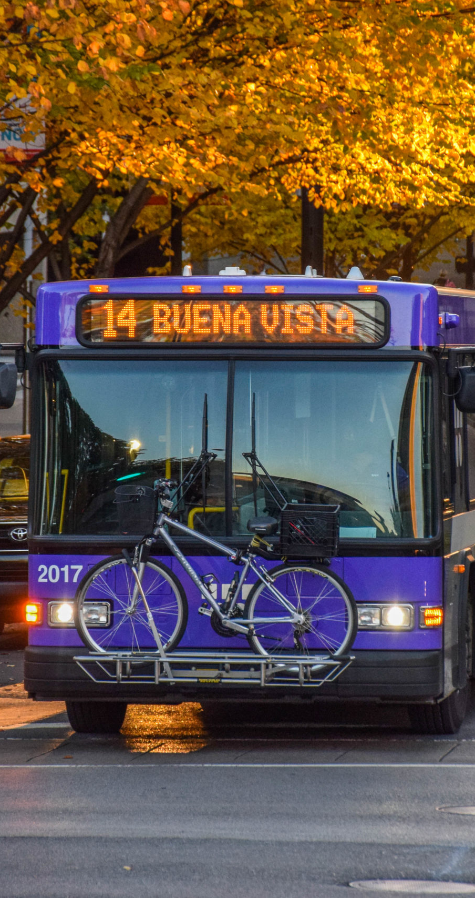
Why This Matters
Reliability Is the Rider’s Experience When buses run late, early, or unevenly spaced, riders experience uncertainty — OTP and headway metrics directly reflect customer satisfaction.
Data Brings Focus to Performance Discussions Quantifying where and when reliability varies gives WeGo leadership a shared, factual baseline for evaluating service quality and trends.
Supports Continuous Improvement Enables WeGo to track progress, compare corridors, and assess strategies for maintaining consistent, dependable service over time.
Notes:
Slide 5—Why This Matters Speaker Notes: (Brandon)
Reliability is the rider’s experience. When buses run late, early, or unevenly spaced, riders feel that uncertainty — it directly affects how dependable the service seems.
Using data brings focus to those performance discussions. It shows where and when reliability varies, giving WeGo leadership a shared, factual view of service quality.
And by tracking these trends over time, WeGo can measure progress and guide strategies to deliver more consistent, dependable service for every rider.

Slide 6
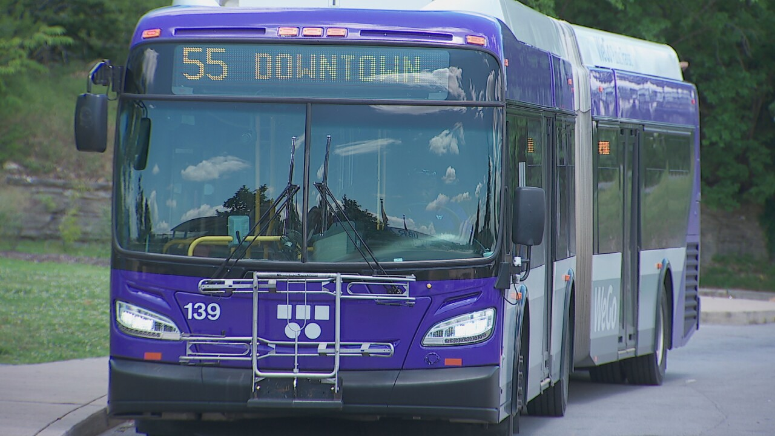
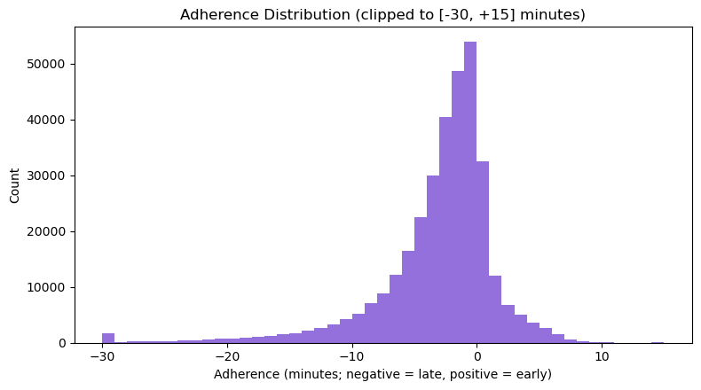
How On Time Are WeGo Buses?
About 80% on-time, 17% late, 3% early
The median adherence is about -2 minutes, indicating a modest tendency to run late
Most data clusters slightly below zero, meaning a small average delay
Notes:
Slide 6—Q1--Overall On-Time Performance Speaker Notes: (Brandon)
To start, we looked at the overall on-time performance across the entire WeGo system. Our dataset includes detailed adherence values — meaning how early or late each bus left a scheduled stop. The results show an on-time performance of about 80%, with roughly 17% of trips running late and 3% running early. When we visualize this in a histogram, the pattern skews slightly to the left — most trips cluster a few minutes behind schedule, with a median adherence around minus 2 minutes. This tells us that lateness is more common than earliness, but not extreme. The takeaway here is that WeGo operates with generally solid reliability, and this figure — about 80% on-time — gives us a baseline for tracking future performance trends and understanding where improvements can be made.

Slide 7
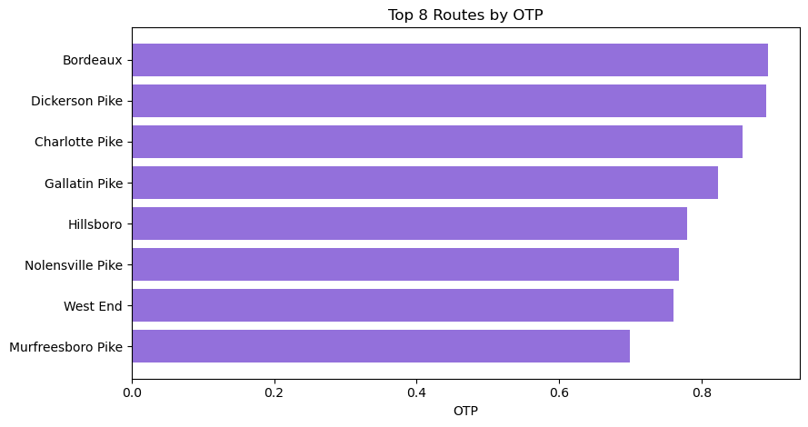
Boxplot or bar chart: average adherence by route
Where and Which Way Matters
OTP ranges from 70% - 89%
Downtown-bound trips trend lower
Notes:
Slide 7—Q2--Route & Direction Effects Speaker Notes: (Brandon)
Next, we analyzed on-time performance by route and direction. Here, the results showed quite a bit of variability. Across all routes, OTP ranged from roughly 70% on the low end up to 89% on the high end. When we compared downtown-bound trips to non-downtown routes, we found that downtown routes consistently performed worse, which makes sense given traffic congestion and higher passenger volumes. This breakdown helps leadership pinpoint where reliability is strongest and where targeted review or intervention is most needed — especially along busy corridors or during high-demand periods.

Slide 8
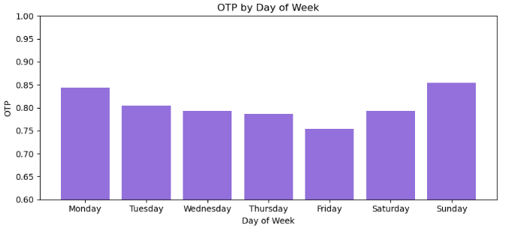
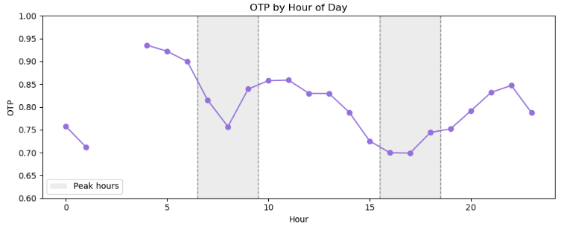
When Are Delays Most Common?
Fridays show the lowest reliability – 75%
Sunday has the highest reliability – 85%
Peak service – 76% on-time
Off peak – 82%
Notes:
Slide 8—Q3--Time of Day and Day of Week Speaker Notes: (Brandon)
Then, we looked at how on-time performance changes across different times of day and days of the week.
We grouped trips into peak hours — typically morning and evening rush periods — versus off-peak times like mid-mornings and early afternoons. The results show that peak-hour OTP averages around 76%, while off-peak performance improves to about 82%.
When broken down by day of week, Fridays consistently show the lowest reliability, likely due to heavier traffic and end-of-week variability. In contrast, Sundays had the highest on-time rate, when traffic is light and schedules are more consistent.
These findings reveal when performance dips. Providing insights that can help WeGo adjust schedules, staffing, or dispatching to improve consistency during the most challenging periods.

Slide 9
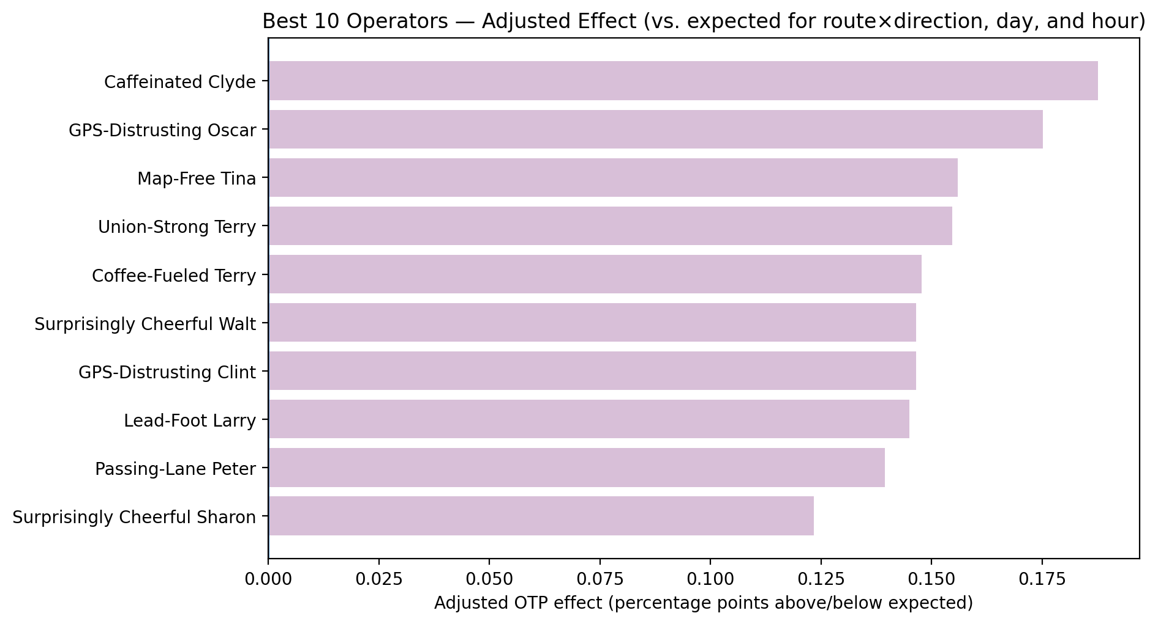
Smooth Operator: Does the Driver Make the Difference?
Compared to expected on-time performance percentage.
Adjusted to account for route, day of the week, and hour of the day.
Only considering drivers with >200 stops.
Identifying common practices amongst drivers with an OTP of .10 or higher is recommended.
Notes:
Each bar is a driver (we show a friendly alias instead of their ID).
The bar measures the driver’s adjusted effect on the on-time performance, in percentage points (pp).
Adjusted means we’ve already accounted for the route and direction they were on, the day of week, and the hour of day.
In other words, we compare drivers to what would be expected given their assignments and time-of-day mix.
Positive bars (to the right) mean the driver’s trips were more on-time than expected; negative bars mean less on-time than expected.

Slide 10
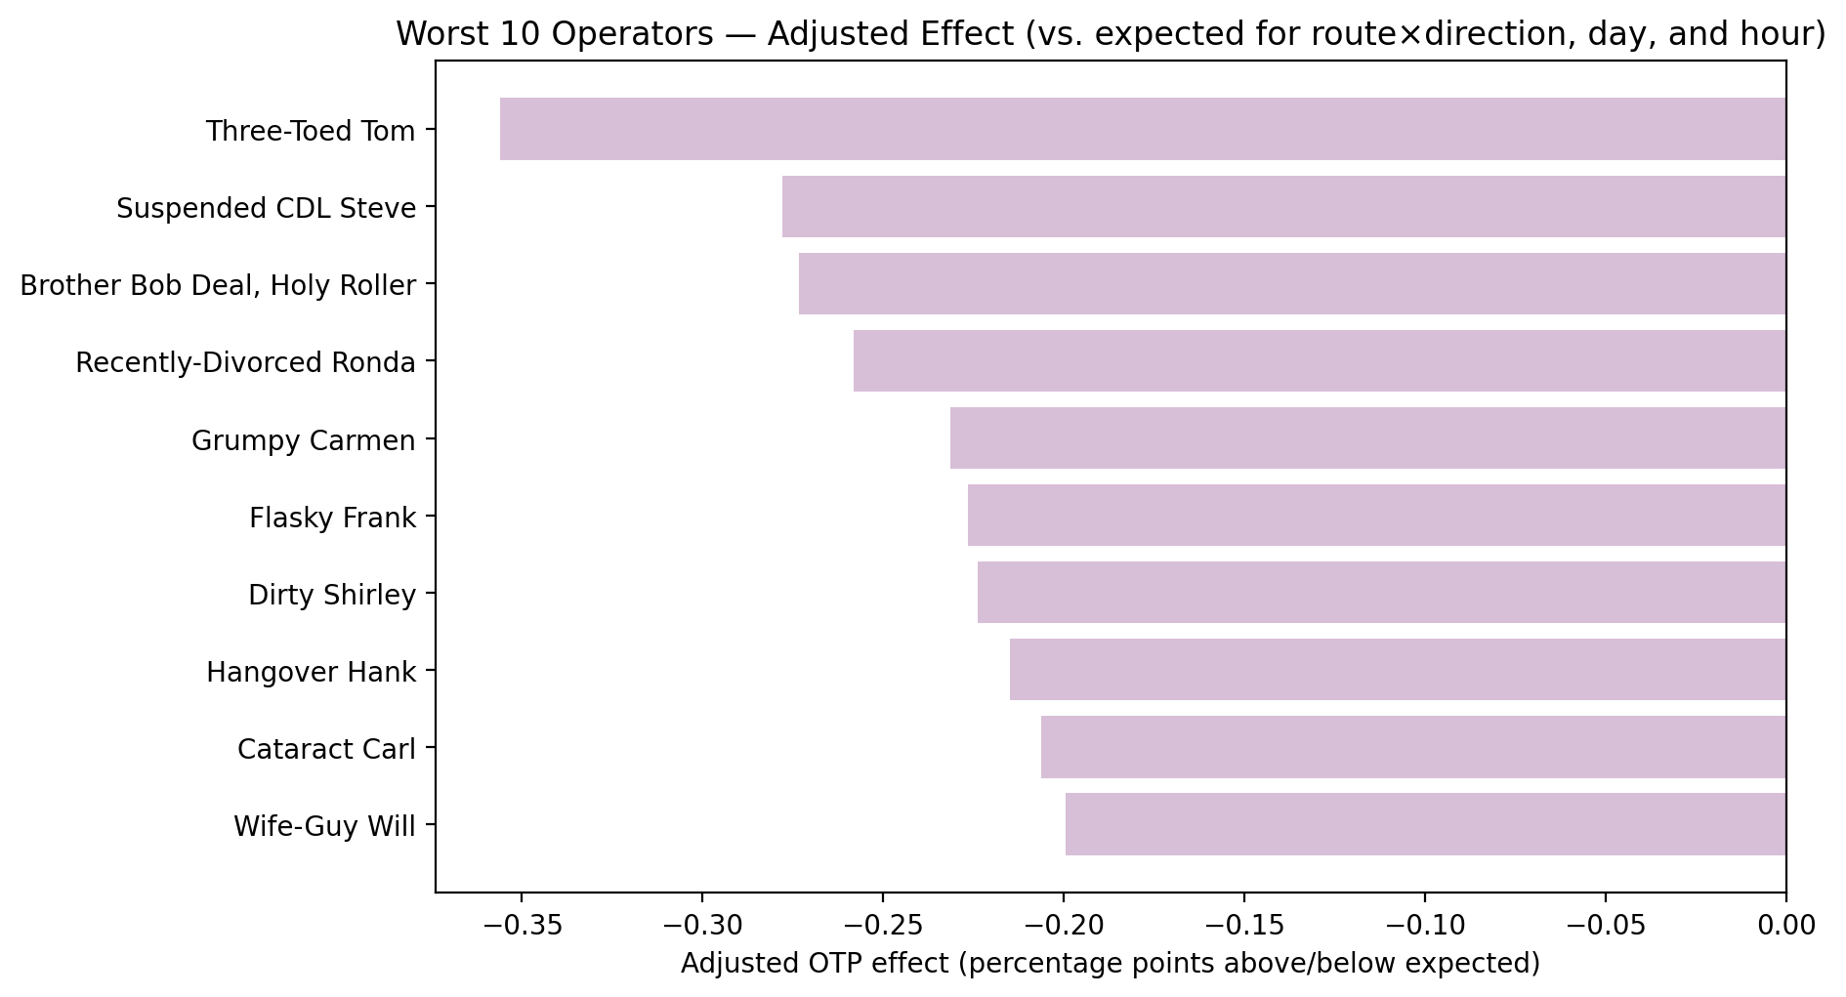
Smooth Operator: Does the Driver Make the Difference?
Noticeable spread in operator-level OTP outcomes from –0.35 to .18
Targeted feedback, coaching, and schedule support are the recommended next steps for those with an OTP of –0.10 or lower.
10
Notes:
Operator (Driver) Impact Speaker Notes:
Operator performance varies ~-0.35 to 0.18
Differences shrink after adjusting for route; conditions more impactful than driver.
Top operators can share best practices.

Slide 11
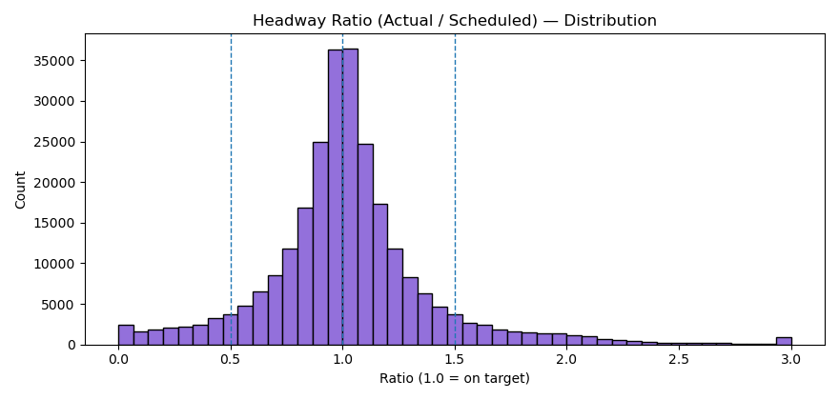
Gasping at Gapping: Headway and Its Effects
Notes:
Here we’re looking at the distribution of the ratio between actual and scheduled headway, how early or late buses are spaced relative to planned timing.
Most buses cluster around a ratio of 1.0, meaning they’re spaced close to schedule, exactly what we want.
Those dashed lines around 0.5 and 1.5 mark our ‘acceptable’ band, so we're working with a plus or minus 50% timing structure.
Outside those lines, you can see evidence of bunching (too close together) and gapping (too far apart).”

Slide 12
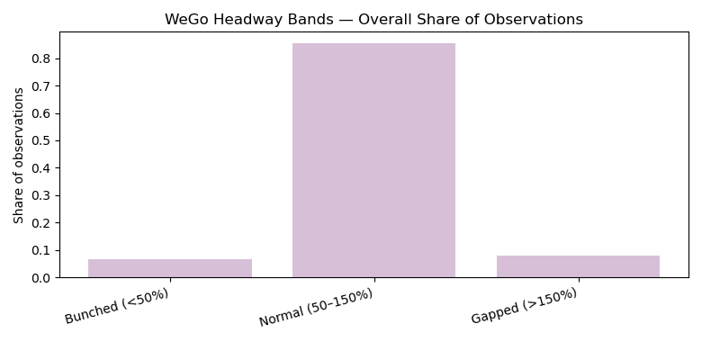
Gasping at Gapping: Headway and Its Effects
Notes:
So we can group those findings into bands to show the percentages of headway observations that fall outside of our acceptable range.
About 85% of observations fall within the normal band.
Around 7–8% show bunching.
And another 8% are gapped.
So while the majority of trips maintain expected spacing, about one in six buses experience less than ideal headway, contributing to passenger crowding, long waits, and potential problems downstream.”

Slide 13
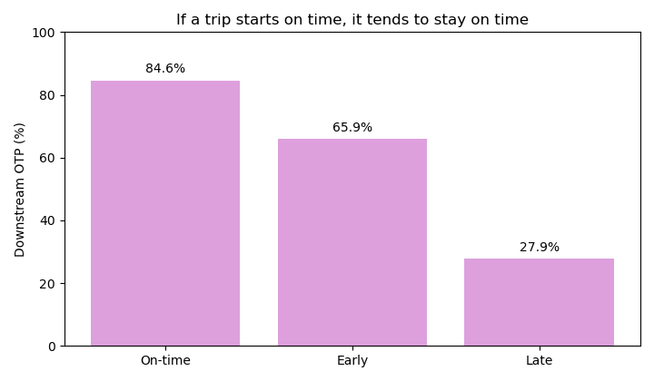
Is It Bussin?
The first stop sets the tone
Trips that start on time have the best downstream OTP and the lowest average deviation
Notes:
Adherence & Headway Deviation Speaker Notes:
Late buses cause gaps; next buses bunch up.
Headway control can improve spacing and reduce passenger wait times.
Here we want to look at the effects that starting off-schedule at the first stop affects with regards to downstream adherence.
This bar chart shows the downstream on time percentage for trips that began on-time, early, or late.
On-time starts had an downstream on time percentage of 84.6%
Early starts at 65.9% OTP
Late starts were only 27.9% on time downstream
That means delays tend to snowball — trips that start off-schedule rarely recover.

Slide 14
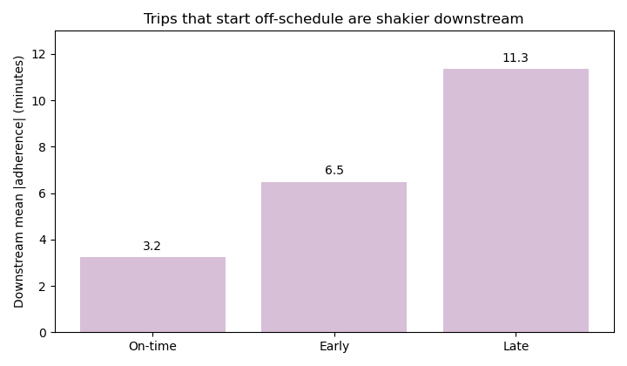
Is It Bussin?
Trips that start late rarely recover
Downstream OTP is lower by 56.8% vs trips that start on time
Trips that start early also underperform
Downstream OTP is lower by 18.7% vs on-time starts and average deviation is higher
Notes:
NThis bar chart shows the downstream on time average adherence for trips that began on-time, early, or late. This simply shows the average deviation in minutes from the scheduled time according to those three buckets we talked about: how likely is our operator to be on time if they start off on-time, early, or late.
On-time starts averaged about 3.2 minutes of deviation downstream.
Early starts average about 6.5 minutes.
Late starts averaged over 11 minutes.
The takeaway is clear: stability at the start of a route strongly predicts performance later on.”

Slide 15

Does Layover Time Impact Downstream Performance?
What is the impact of layover time at the start of a trip?
Do longer layovers lead to more stable performance throughout the trip?
Think of layover as recovery time at the start of the trip before a bus leaves the terminal
Very short/zero layovers leave no time for the operator to ‘reset’
Notes:
Stretch Goals: Additional Insights Speaker Notes:
Being late at first stop predicts downstream delays.
Longer layovers correlate with more stable headways.
Delays accumulate over distance/time; further along the route, adherence is less stable.

Slide 16
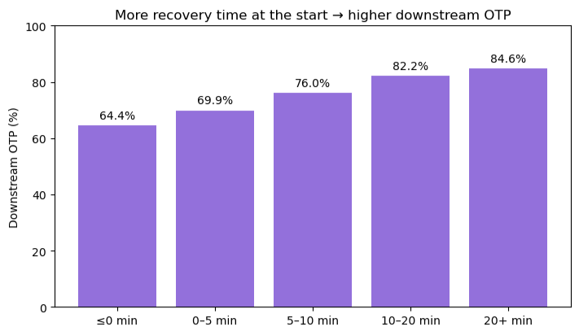
Layover Time Impacts Downstream On-time Performance
Findings:
Trips with a longer recovery time tend to stay steadier and more on-time than those with less layover
Reminder: average OTP is 80%, suggesting that layovers <10 minutes contribute to lower OTP
Notes:
Adherence & Headway Deviation Speaker Notes:
Positive correlation (~0.45) between lateness and headway deviation.
Late buses cause gaps; next buses bunch up.
Headway control can improve spacing and reduce passenger wait times.

Slide 17
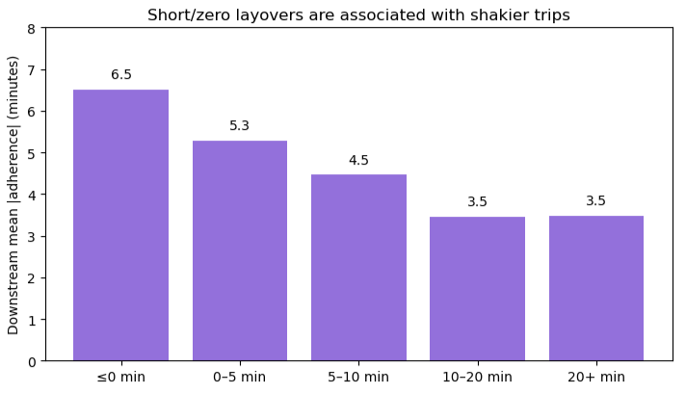
Layover Time Impacts Downstream Schedule Adherence
Findings:
Trips with shorter recovery time have higher variability downstream, suggesting that a 'reset' helps maintain downstream schedule adherence
The data also suggest that layover times >20 minutes are no more beneficial to downstream schedule adherence than 10-20 minutes
Notes:
Adherence & Headway Deviation Speaker Notes:
Positive correlation (~0.45) between lateness and headway deviation.
Late buses cause gaps; next buses bunch up.
Headway control can improve spacing and reduce passenger wait times.

Slide 18
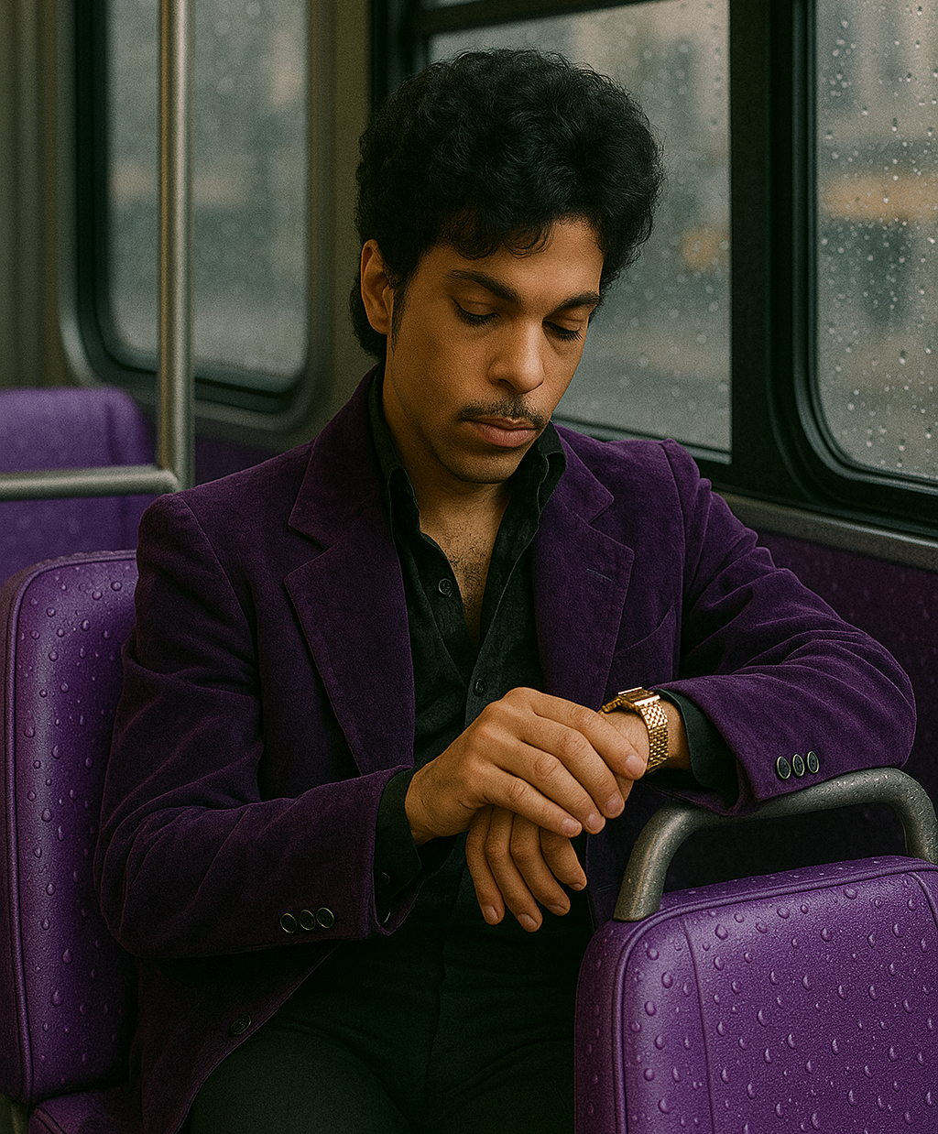
How Does Performance Change Over the Course of a Trip?
How often is the trip started on-time?
How does on-time performance change throughout the trip?
We split each trip into ten slices from the start (0–10%) to the end (90–100%).
Then looked at the performance of each slice of the trip against the schedule
Notes:
Stretch Goals: Additional Insights Speaker Notes:
Being late at first stop predicts downstream delays.
Longer layovers correlate with more stable headways.
Delays accumulate over distance/time; further along the route, adherence is less stable.

Slide 19
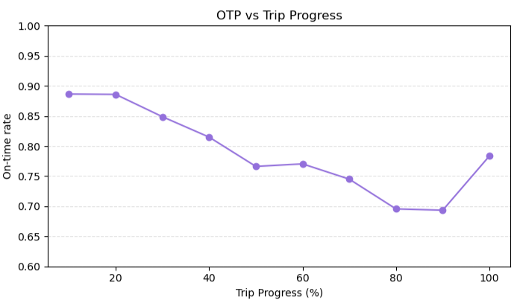
On-time Performance Suffers Mid-trip, then Recovers
Findings:
Start of trip: 88.6% on-time
End of trip: 78.4% on-time
On-time performance decreases by 10.3 percentage points from the start to the end of a typical trip.
The data suggests that mid-trip conditions may influence service consistency, as the OTP increases at the end of a trip
Notes:
Adherence & Headway Deviation Speaker Notes:
Positive correlation (~0.45) between lateness and headway deviation.
Late buses cause gaps; next buses bunch up.
Headway control can improve spacing and reduce passenger wait times.

Slide 20
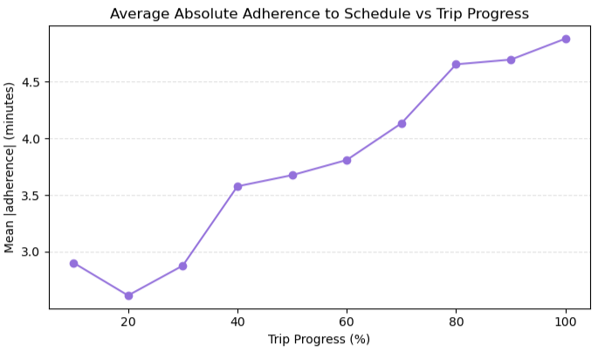
Adherence to the Schedule also Suffers Mid-trip, then Recovers
Findings:
Start of trip: 2.90 minutes off-schedule on average
End of trip: 4.88 minutes off-schedule on average
Average absolute adherence drifts farther from schedule by 1.98 minutes over the course of a trip
Data suggests that the average trip's reliability declines during the middle of the trip, then recovers near the end
Notes:
Adherence & Headway Deviation Speaker Notes:
Positive correlation (~0.45) between lateness and headway deviation.
Late buses cause gaps; next buses bunch up.
Headway control can improve spacing and reduce passenger wait times.

Slide 21
Key Takeaways
Primary Finding | Why It Matters for Operations Leadership
Overall OTP averages 80% | Provides baseline reliability level for leadership to monitor and compare over time.
Reliability varies by route and direction: Bordeaux near 90%, Murfreesboro near 70%; Downtown less reliable | Highlights where service consistency differs, helping leadership focus on route-level reviews.
Performance differs by day/hour: dips during peak hours (76%) and improves off-peak (82%); Fridays lowest, Sundays' highest. | Provides time-of-day and day-of-week context, clarifying when reliability challenges most often occur.
Starting time matters: late or gapped departures stay less reliable. | Offers a trip-level perspective on how early-run conditions shape overall route reliability.
Layovers boost performance: Longer layovers correlate with steadier spacing. Late trips create gaps, early trips cause bunching. | Connects schedule structure and spacing stability, illuminating how timing affects rider experience.
On-time performance deteriorates mid-trip: strongest at the start of trips and decreases mid-route before stabilizing near the end. | Clarifies which portions of routes are most vulnerable to reliability decline, supporting more informed discussion of mid-route factors and schedule design.

Slide 22
Next Steps: Turning Data into an Ongoing Reliability Framework
Diagnostics and Future Enrichment | Dive Deeper into Monitoring and Analysis
Study Schedule Structure Effects Quantify how layover duration and trip start time affect downstream OTP and headway stability. Develop a “Trip Health” Diagnostic Metric Combine schedule adherence and spacing indicators to flag stable vs variable trips to detect reliability issues early. Expand the Data Pipeline Integrate detailed traffic, weather, and event data into future enrichments to build a multifactor reliability model explaining variation over time and space. | Automate Reliability Dashboards Monthly OTP and headway reports by route, direction, and time of day to establish a consistent reliability baseline with multiple layers. Analyze Operators & Trip Consistency Examine operators and mid-trip stop variability to understand where performance outcomes diverge. Visualize Bus Stop Hotspots Use timepoint and mapping outputs to locate clusters of lateness and spacing gaps for corridor-based review. View Preliminary Hotspot Vizualization Here

Slide 23

Thank You
Notes:
Thank You!

